Slide 1

Red Hat System Administration I 10.0
Chapter 1
Dilara Gülenç

Slide 2
Why Should You Learn about Linux?
From Web Browsing to Supercomputers
Daily Web & E-Commerce: Powers the web servers and shopping platforms users access daily
Data Center Core: Predominant enterprise OS alongside Microsoft Windows
Embedded Tech: Runs smart TVs and in-flight entertainment systems
Modern Architecture: Powers the cloud revolution, containers, microservices, and big data
Data Center Core: Predominant enterprise OS alongside Microsoft Windows

Slide 3
Why Should You Learn about Linux?
Essential Driver for IT Careers
Windows Interoperability: Enables cross-platform system and app management
Application Hosting: Serves as the primary runtime environment for developers
Cloud Computing: Powers both public and private cloud instances
Mobile & IoT: Forms the operating base for mobile apps and connected devices
Career Growth: Unlocks high-demand opportunities across the IT industry

Slide 4
What Makes Linux Great?
Open Source Model: Full code visibility, freedom to experiment, and faster community innovation
Powerful Command-Line (CLI): Native automation, rapid scripting, and simplified local/remote management
Modular Architecture: Easy component replacement, flexible upgrades, and custom-tailored systems
Workstation to Appliance: Scales seamlessly from full development machines to minimal appliances

Slide 5
What Is Open Source & Its Benefits
Core Definition: Software distributed with human-readable source code under royalty-free licenses
Open Source vs. Proprietary: Replaces closed black-box models with full transparency and collaborative innovation
Commercial Integration: Powers enterprise operations; commercial vendors (like Red Hat) provide enterprise support
Key User Benefits:
  Control: Inspect exactly what the program does and adapt it
  Training: Learn directly from production-grade, real-world code
  Security: Audit sensitive logic and fix vulnerabilities independently
  Stability: Ensures code survives even if the original author departs

Slide 6
What Is Open Source & Its Benefits
Copyleft (Share-Alike):
Mandates that redistributed code and improvements remain open
Examples: GNU GPL, GNU LGPL
Permissive Licenses:
Maximizes reuse; allows code integration into proprietary products
Examples: MIT, Apache 2.0, Simplified BSD
Who Develops Open Source?
Professional Dominance: Mostly paid engineers funded by enterprises for strategic innovation
Collaborative Community: Volunteers and academia drive rapid growth in emerging technologies

Slide 7
What Is a Linux Distribution?
01. THE CORE KERNEL | 02. SYSTEM COMPONENTS | 03. THE DISTRIBUTION
Linus Torvalds (1991) Manages hardware, system memory, and process scheduling under the GPL license. | GNU, Wayland & Servers Adds shells, utilities, Apache, and Sendmail to create a complete UNIX-like environment. | Prebuilt & Tested Solves assembly complexity by providing easy installation, updates, and vendor support.

Slide 8

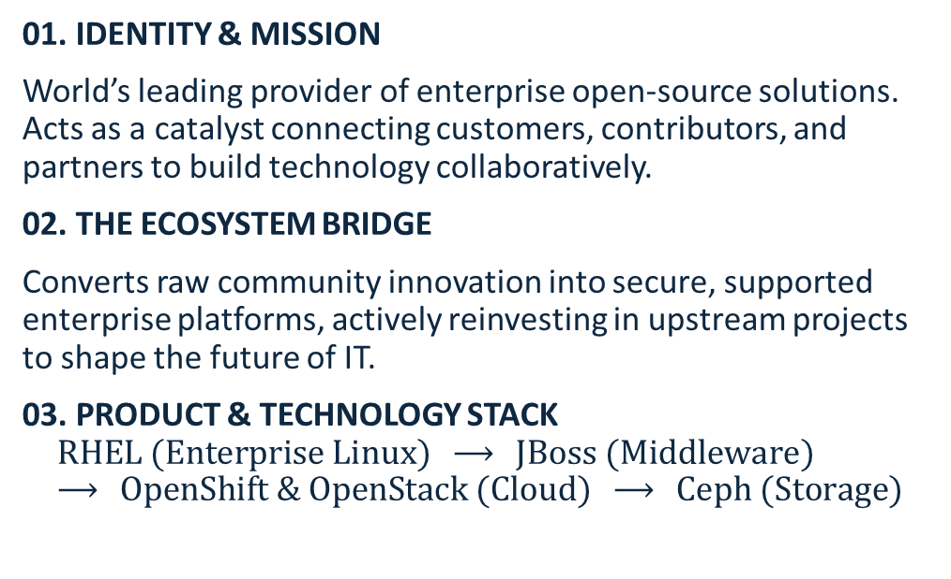
RED HAT: CONNECTING ENTERPRISE TO OPEN SOURCE
01. IDENTITY & MISSION
World’s leading provider of enterprise open-source solutions. Acts as a catalyst connecting customers, contributors, and partners to build technology collaboratively.
02. THE ECOSYSTEM BRIDGE
Converts raw community innovation into secure, supported enterprise platforms, actively reinvesting in upstream projects to shape the future of IT.
03. PRODUCT & TECHNOLOGY STACK
$$\text{RHEL (Enterprise Linux)} ⟶ \text{JBoss (Middleware)} ⟶ \text{OpenShift \& OpenStack (Cloud)} ⟶ \text{Ceph (Storage)}$$

Slide 9
The Red Hat Enterprise Linux Ecosystem
COMMUNITY ENGINE
Fedora & EPEL (~62K Packages)
Upstream innovation and experimental proving ground. EPEL extends community packages to production platforms.
02. CONTINUOUS STAGING
CentOS Stream (~8.1K Packages)
Transparent continuous delivery pipeline where mature upstream software is stabilized directly for RHEL.
03. PRODUCTION & SPECIALIZATION
RHEL, UBI & CoreOS (RHCOS)
0-year enterprise release supplying components to Universal Base Images (UBI) and container-ready OpenShift hosts.

Slide 10
RHEL Continuous Development & Cadence
PHASE 01
Fedora Rawhide & Fedora 40
Rawhide provides the continuous upstream bed; Fedora 40 branches out to become the code base for RHEL 10.
PHASE 02
CentOS Stream 10 Staging
Nightly integration and regression testing platform where upstream commits are hardened before release.
PHASE 03
RHEL 10 Beta to RHEL 10.0 GA
Public testing through beta releases culminating in certified production-ready 10-year enterprise stability.

Slide 11
Distribution Comparison & Enterprise Readiness
Feature / Dimension | Fedora | CentOS Stream | RHEL
Documentation | Community | Community | Red Hat Official
Expert Technical Support | None | None | 24/7 Dedicated Support
Product Security Team | None | None | Dedicated Team
Security Certifications | None | None | Fully Certified
Centralized Management Tools | None | None | Included
Zero-Cost Access Options | Free OS | Free OS | Free Developer Subscription
Hardware Architecture Support: RHEL and CentOS Stream natively support Intel/AMD x86_64, ARM64, IBM Power, and IBM Z
Subscription Model: No open-source software license fees; value delivered via maintenance, certifications, knowledge base access, and ongoing enterprise support

Slide 12

Evolution, Edge & Developer Ecosystem
entOS Evolution (Pre-2019 vs. Today)
Legacy CentOS Linux: Rebuilt downstream after RHEL releases, causing long delays for security patches and duplicated upstream effort
CentOS Stream: Positioned upstream to enable transparent community contributions, faster vulnerability fixes, and continuous delivery
Package Ecosystem: EPEL vs. EPEL Next
EPEL: Fedora SIG repository providing community packages built against stable RHEL releases
EPEL Next: Specialized repository built directly against CentOS Stream for upcoming library rebases and newer build requirements
RHEL for Edge Computing
Image Builder: Rapid generation of lightweight, customized OS images optimized for constrained edge devices
Centralized Fleet Operations: Built-in zero-touch provisioning, real-time system health monitoring, and fast remote remediation

Slide 13
Obtaining Red Hat Enterprise Linux
Community Streams, Evaluations, and Developer Programs
Free Community Channels
  Fedora & Fedora CoreOS: Free community platform accessible via the Fedora Project
  EPEL & EPEL Next: Free repository packages for extended enterprise dependencies
  CentOS Stream: Free, direct access to the continuously delivered upstream code
RHEL Evaluation Download
  Available via a free Red Hat Customer Portal account
  Includes limited-time access to official product support and updates
  Operating system remains functional after the evaluation period concludes
Red Hat Developer Subscription
  Free, self-supported subscription for individual developers
  Identical software bits to production RHEL for prototyping, testing, and demos
  Delivers continuous product updates for ongoing learning and development

Slide 14
Obtaining Red Hat Enterprise Linux
Cloud, Containers & Modern Deployment
Public Cloud Platforms (AWS, GCP, Azure)
  Pre-built, official RHEL images available across major hyperscalers
  Red Hat Cloud Access: Enables portable subscription management across hybrid and multi-cloud architectures
Universal Base Images (UBI)
  Freely usable for container development and distribution without a paid subscription
  Enterprise support and non-UBI software require a licensed RHEL or OpenShift platform
Image Mode for RHEL 10 (bootc)
  Container-native deployment approach using bootable container images
  Standard container build and registry workflows (build, push, deploy)
  Prevents infrastructure drift while simplifying scalability and system troubleshooting

Slide 15
Lesson Summary & Key Takeaways
01. OPEN SOURCE | 02. LINUX DISTRIBUTIONS | 03. ENTERPRISE RHEL
Freedom & Collaboration Software with source code that anyone can freely study, modify, improve, and share royalty-free. | Assembled Ecosystem Complete, installable OS built around the Linux kernel, packing essential libraries and GNU tools. | Production-Ready Platform Red Hat stabilizes community innovations into certified, commercially supported enterprise software.

